Slide 1
Image classification
Squad Team

Slide 2
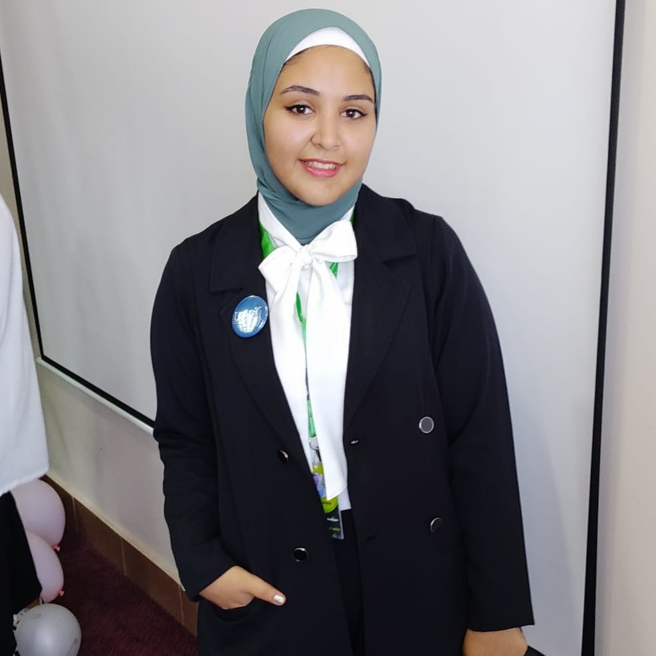
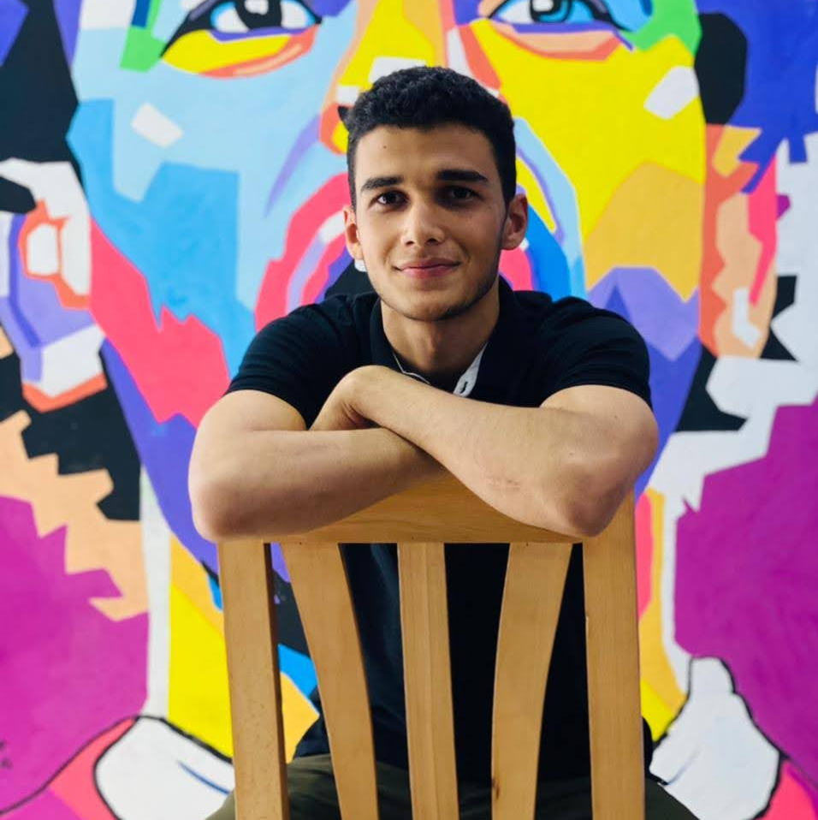
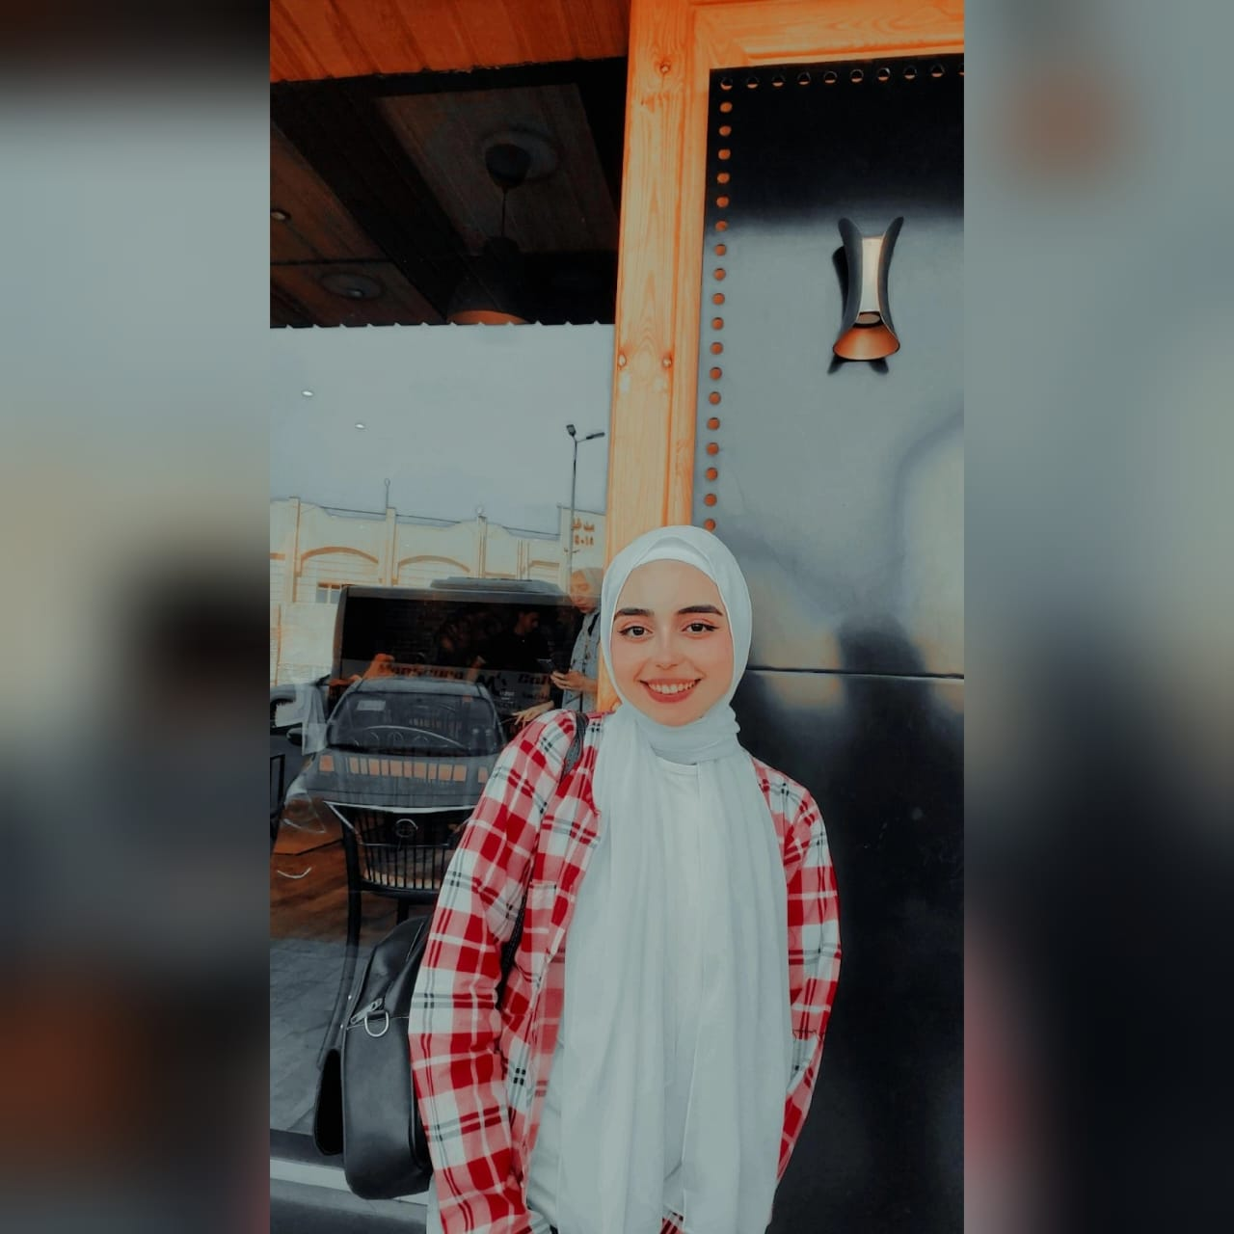
OUR TEAM
Marwa elsayed kahlil
Mohamed ayman
Rania HOSSAM
Faculty of Artificial Intelligence KSU
Faculty of engineering
Elmansoura University
Faculty of Computer &Information science
Elmansoura University

Slide 3
TABLE OF CONTENTS
01
02
03
What is the problem?
How we dealt with it?
future work

Slide 4

What is the problem?
We have a lot of images from camera traps located at different sites. There are seven types of critters captured in this set of images: birds, civets, duikers, hogs, leopards, other monkeys, and rodents. There are also images that contain no animals (blank).

Slide 5
How we deal with it?
Our task is to help the biologists to classify animals using pictures of them taken from camera traps in order to save their natural habitat and prevent their possible extension .
so we follow this steps:

Slide 6
Image preprocessing: To enhance the image features to make it easy for the model to recognize them.
Model Approach : Searching through the state of art Models and finding the best fit for production.
The problem we faced in the development : As its not our first time developing these kind of models we knew already the problems we would face in advance so we have prepared for these kind of problems.

Slide 7
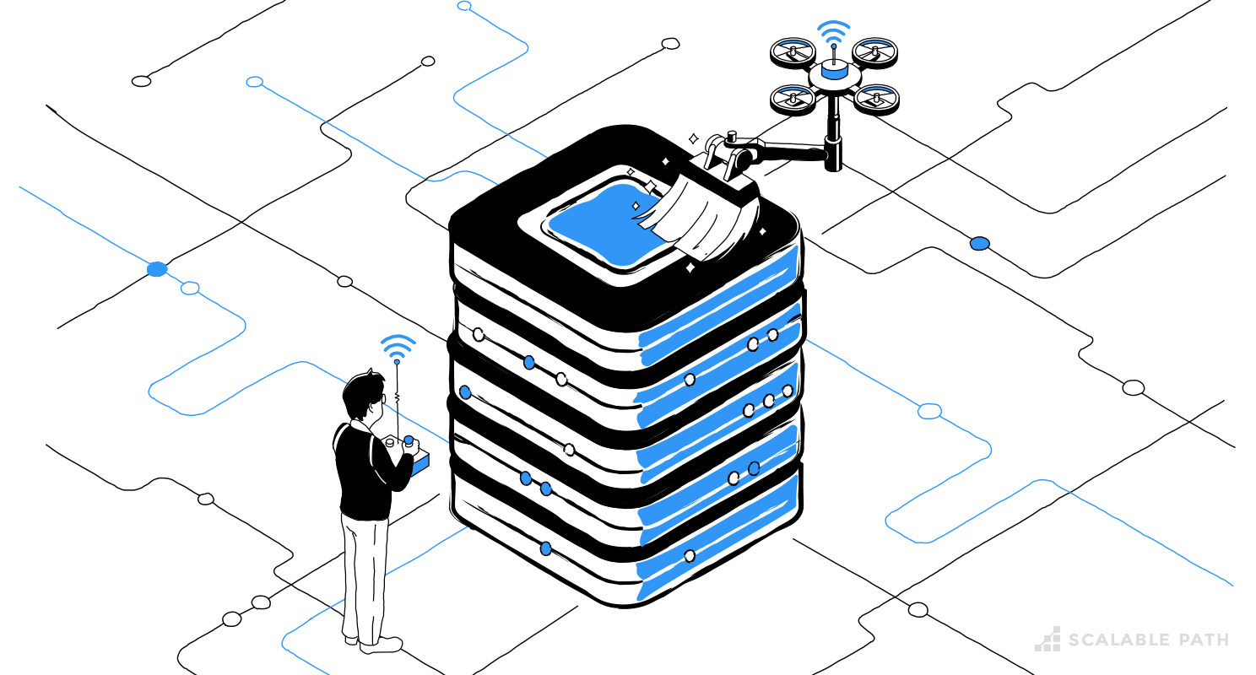
Image preprocessing
Image Preprocessing is an important step in improving the performance of segmentation due to nonuniform illumination of the input image.

Slide 8
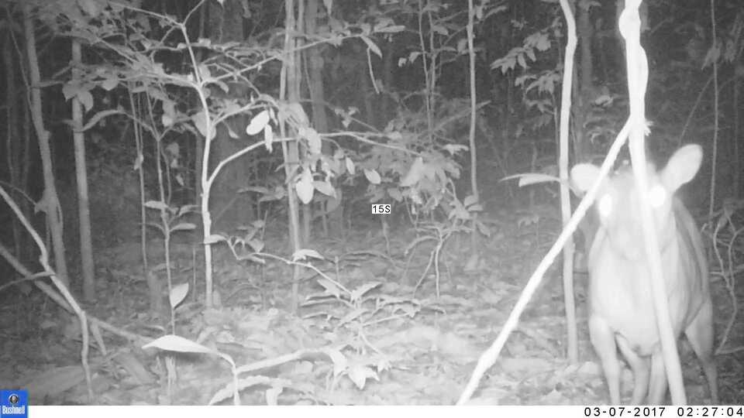
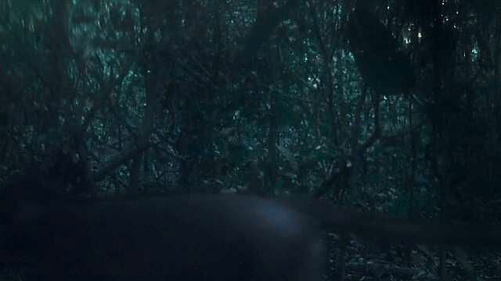
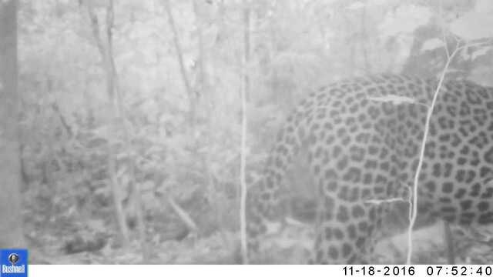
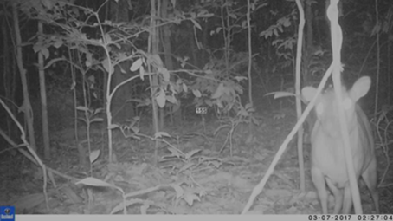
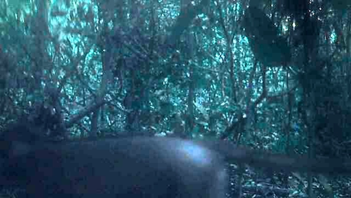
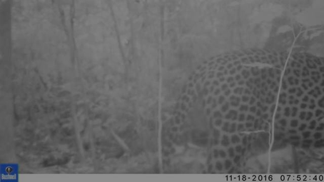
Image preprocessing
1- Gamma Correction
Before
After

Slide 9
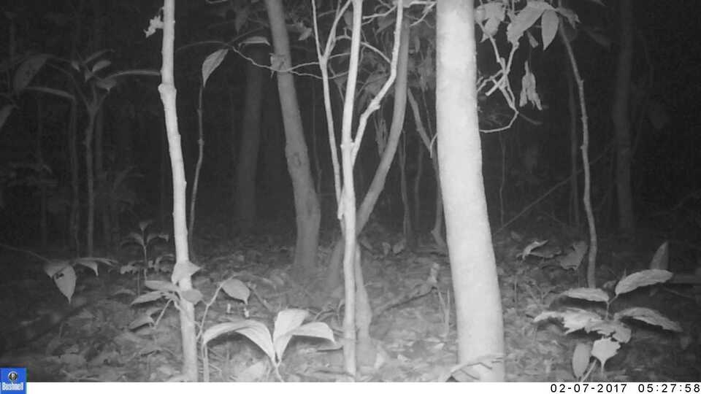
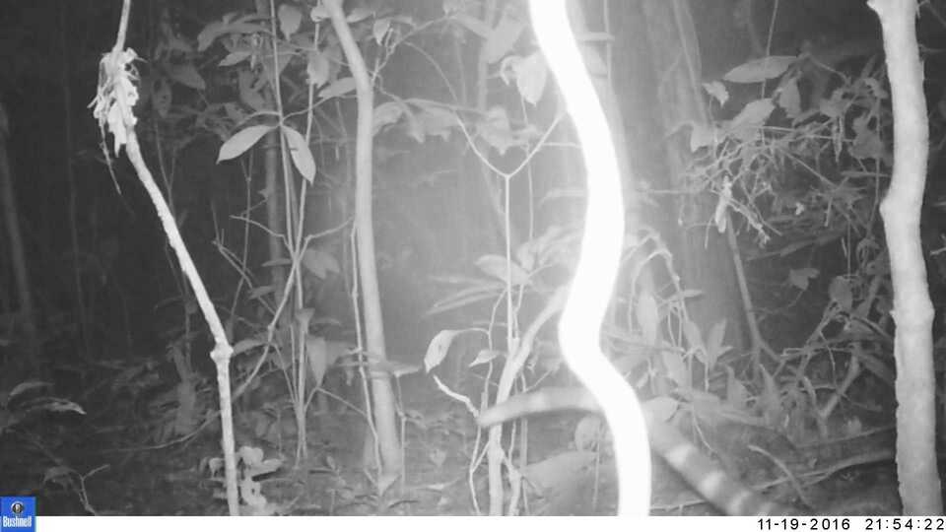
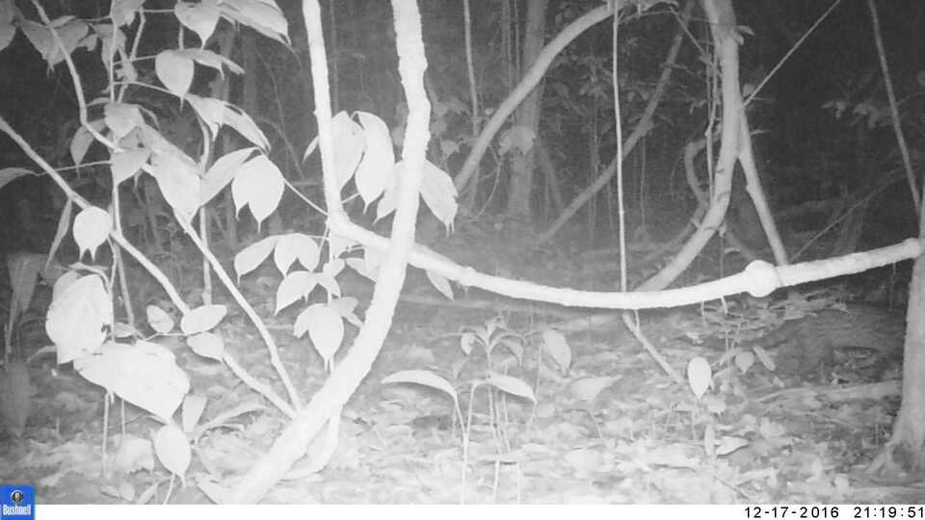



Image preprocessing
2- Image Deblurring
Before
After

Slide 10
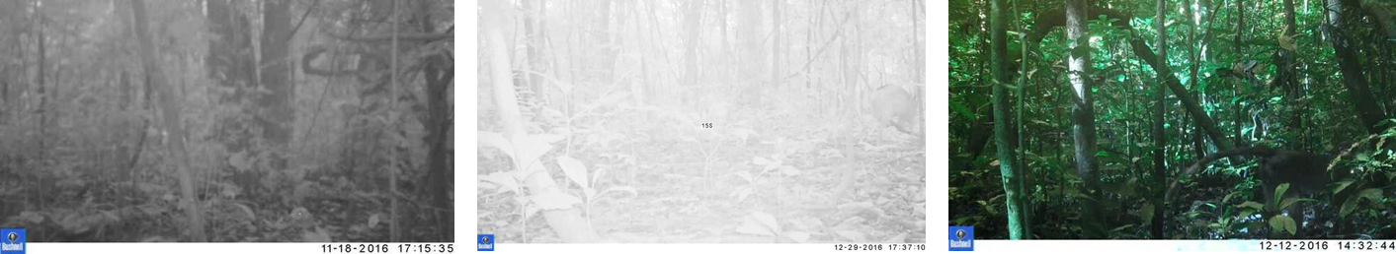
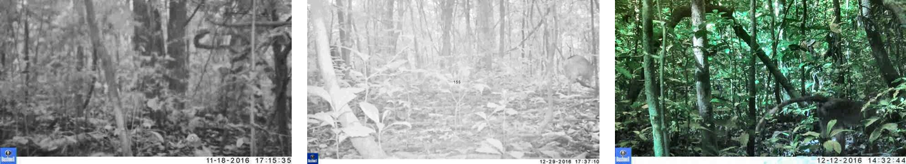
Image preprocessing
Contrast Limited Adaptive Histogram Equalization
3- CLAHE Algorithm
Before
After

Slide 11
Model approach and evaluation

Slide 12

The use of Cnn architecture
Deep learning has developed the way we live in many aspects one of these aspects is computer vision which we try to teach a computer to mimic the human learning process from seeing examples. Deep learning has many great algorithms in computer vision one of them is CNN since it was developed in 1990s CNN has shown us great capabilities and enabled the computer to do many tasks which was hard for it before like object classification, object detection and many more so we used a model inspired from CNN architecture.

Slide 13

Model Choice
As it is tedious to train a model from scratch to our task for reasons like we said it’s hard and also the lack of time.
We decided to fine tune a big model to do our task, fine tuning means using a bigger model that was trained on a bigger dataset than ours then train it on the dataset its like if a model learned how to classify a truck it is also able to classify what a car is as cars and trucks are very similar.

Slide 14
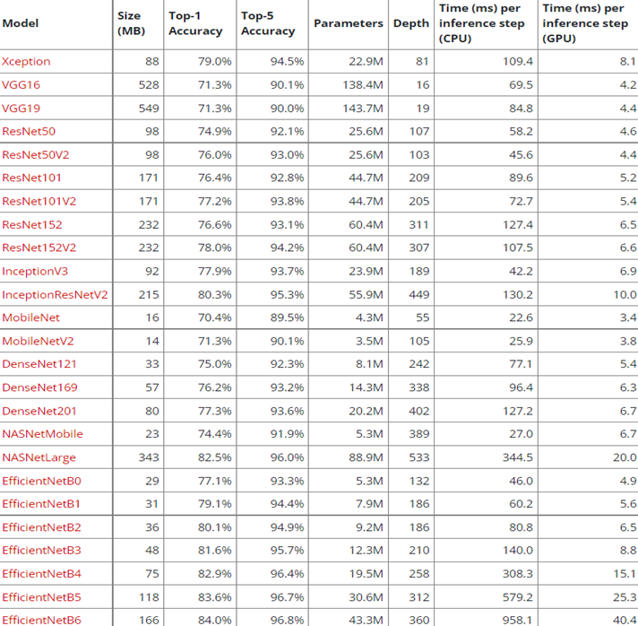
Model Choice

Slide 15
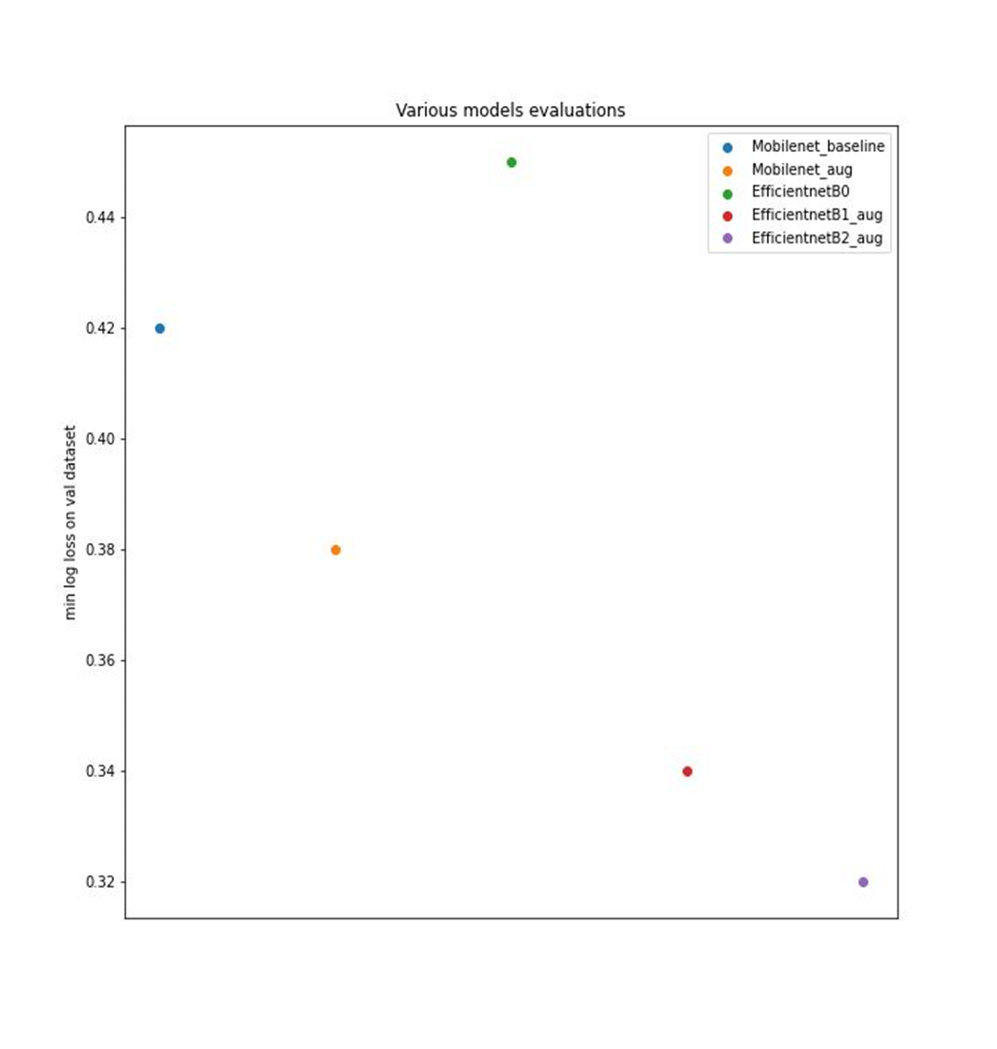
model Evaluation
We decided to choose Mobile net and Efficient net as they are relatively small with excellent accuracy and small running time which enabled us to do testing relatively quickly .

Slide 16
How to improve the performance of the model?‏

Slide 17
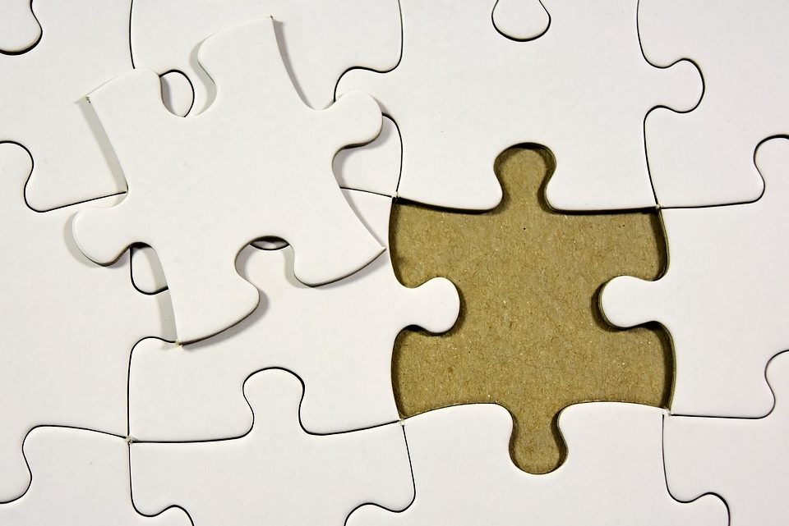
DEALING WITH OVERFITTING
In Overfitting, the model tries to learn too many details in the training data along with the noise from the training data. As a result, the model performance is very poor on unseen or test datasets.

Slide 18
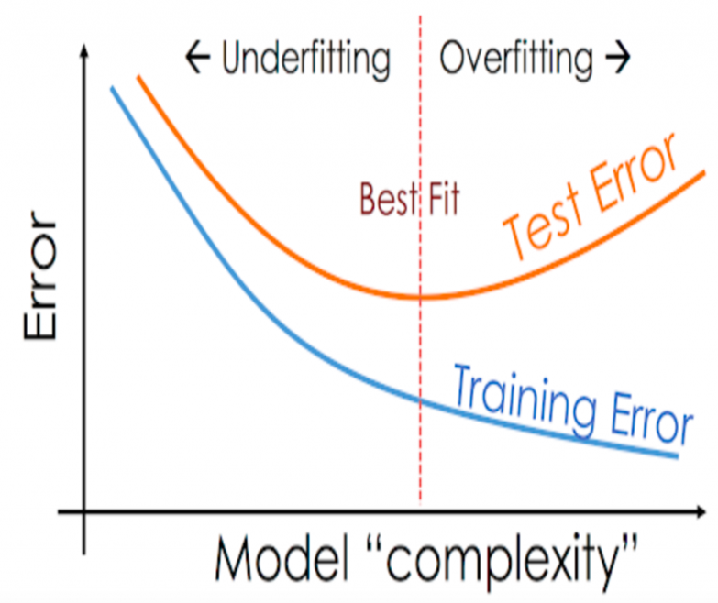
How overfitting affect the performance
As we see after the fit line the performance of training data increase and the performance of test data decrease.

Slide 19
How we handle overfitting
01
02
03
Reduce the Model Complexity
Weight Regularization
reducing the penalizes the network’s large weights & forces the optimization algorithm to reduce the larger weight values
Data Augmentation
removing some layers or reducing the number of neurons the network becomes less prone to overfitting
increase the size of the training

Slide 20
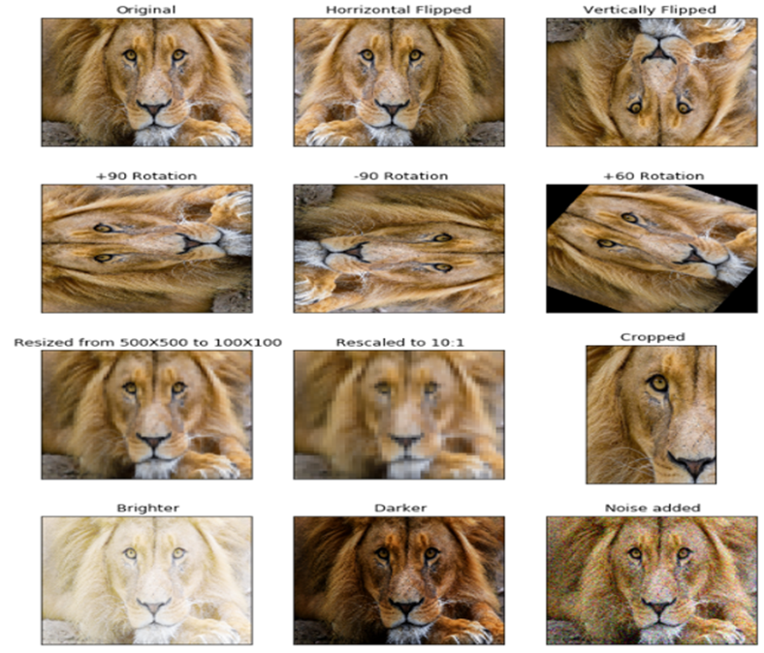
TECHNIQUES OF DATA AUGMENTATION​
PADDING
RANDOM ROTATING
RESCALING
ALL TECHNIQUES
ZOOMING
CROPPING
TRANSLATION

Slide 21
TECHNIQUES OF DATA AUGMENTATION WE USE
Random Flipping
Random Padding
Mix Up
Random translation

Slide 22

Future work

Slide 23
PROPOSED ENHANCEMENT
Further image preprocessing
Model Architecture improvement

Slide 24
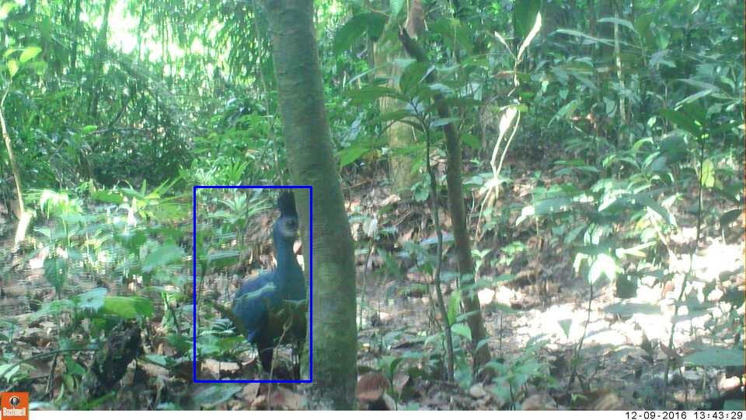
Further image preprocessing
As we have seen in most of the images the animal in each image occupy a small space from it which deludes the model and cause it to misclassify these images so we are proposing a method or another model that can extract the animal coordinates from the image then we crop the animal out of the image our method is inspired from the IWildCam competition in which the competitors used this method to improve their model classification using a model called mega detector.
Animal detection

Slide 25
Model improvement
We thought how to improve our model by modifying the model architecture a little bit so we searched through many papers and found an architecture that seemed to have a promising performance.
In the paper of Learning to resize an image for computer vision tasks a long name I might add, The authors propose a novel architecture for effectively resizing an image instead of using the standard methods like bilinear and bicubic methods

Slide 26
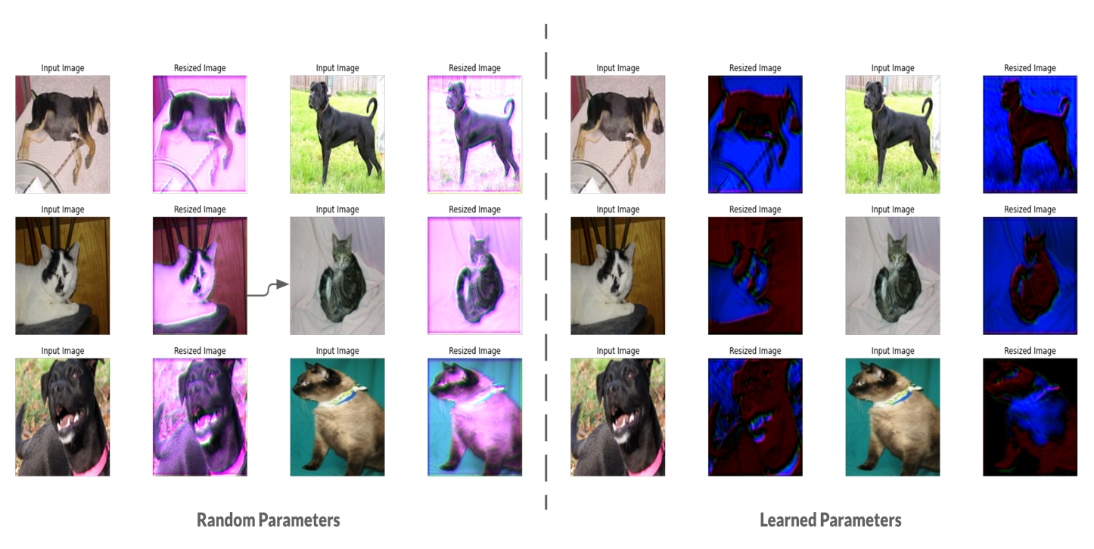
Examples of some preprocessed image

Slide 27
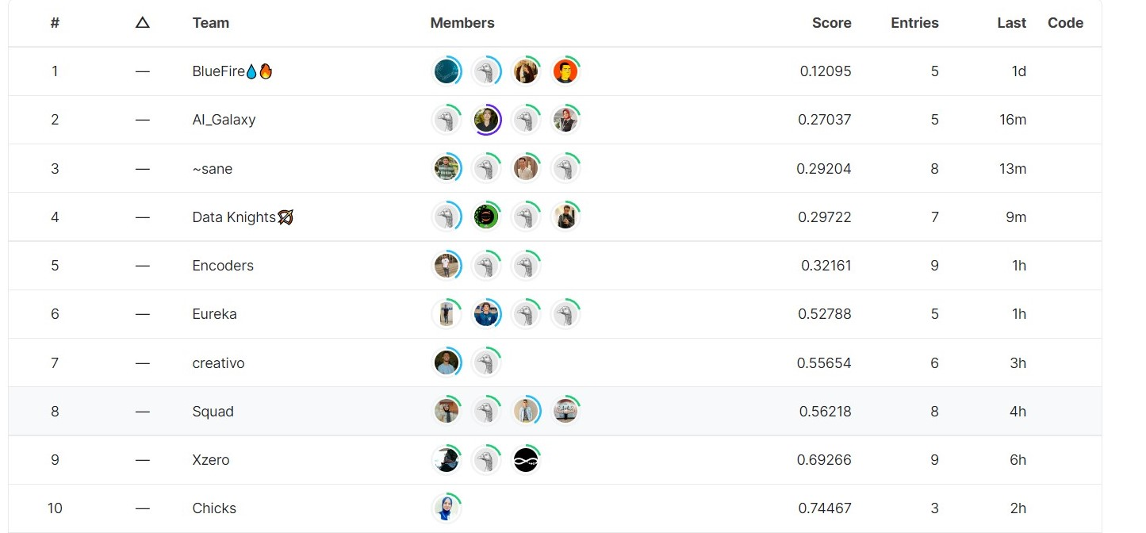
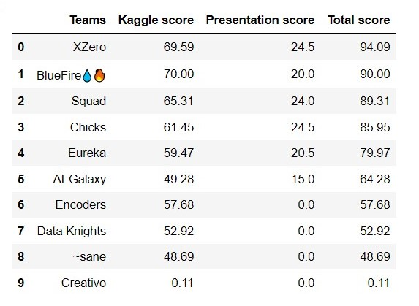
Our Score

Slide 28
THANKS!

